Slide 1

Synthetic Historical Control for Policy Evaluation
Evidence from Satellite Data
September 4, 2026
Yujuan Gao

Slide 2
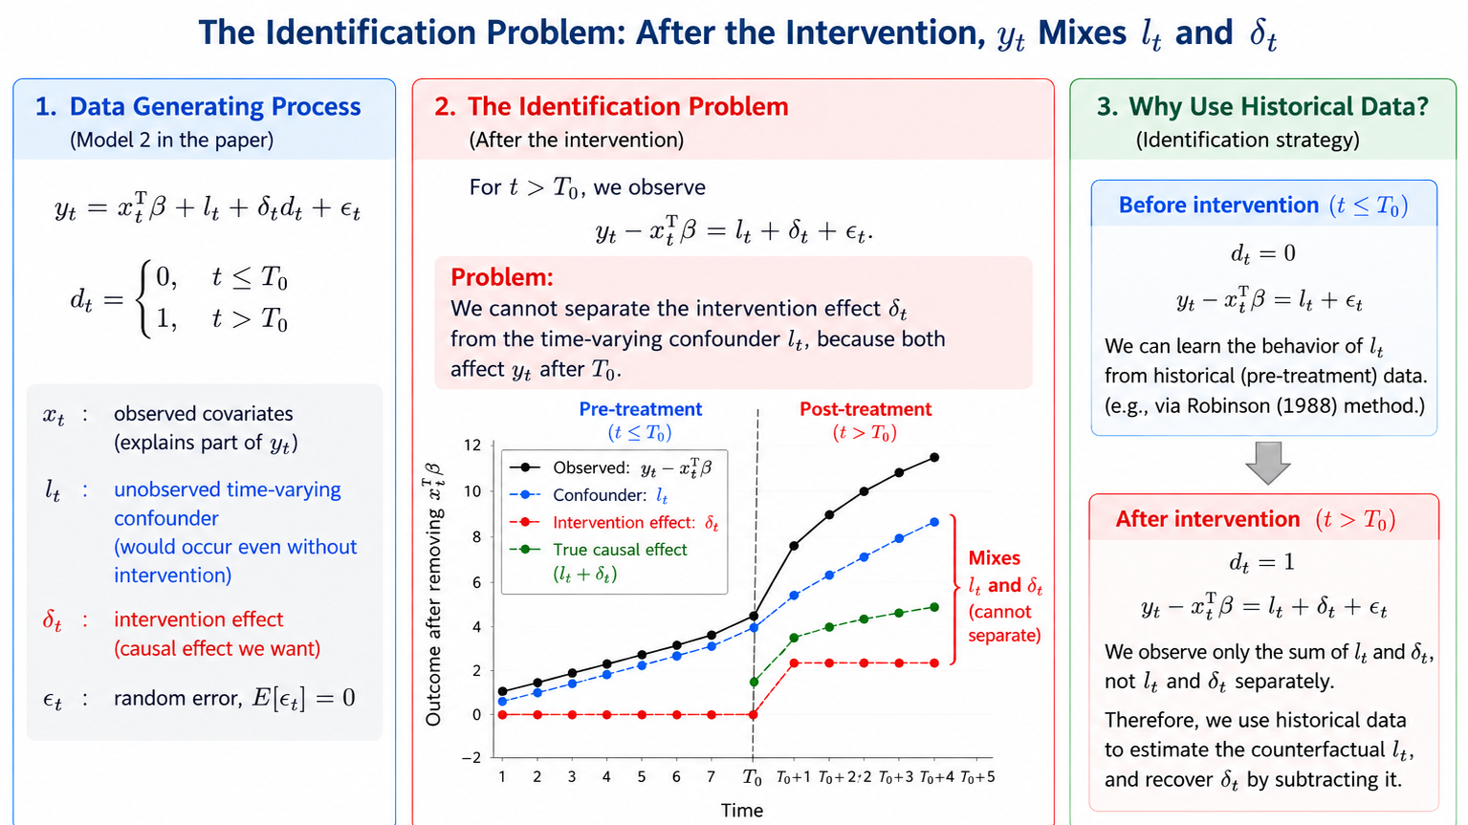
Notes:
The observed outcome is not determined only by the disaster.
satellite outcome is also affected by observed factors and by unobserved time-varying factors.
seasonality, vegetation growth, soil moisture, rainfall conditions, or other environmental changes that would have occurred even without the hurricane.
SCM or augmented SCM, including extensions with multiple outcomes construct the counterfactual using other geographic locations.
geographic donor sites may not provide a credible counterfactual.
nearby locations may also be affected by the hurricane
locations farther away may have very different elevation, vegetation, terrain, land cover, or climate.

Slide 3
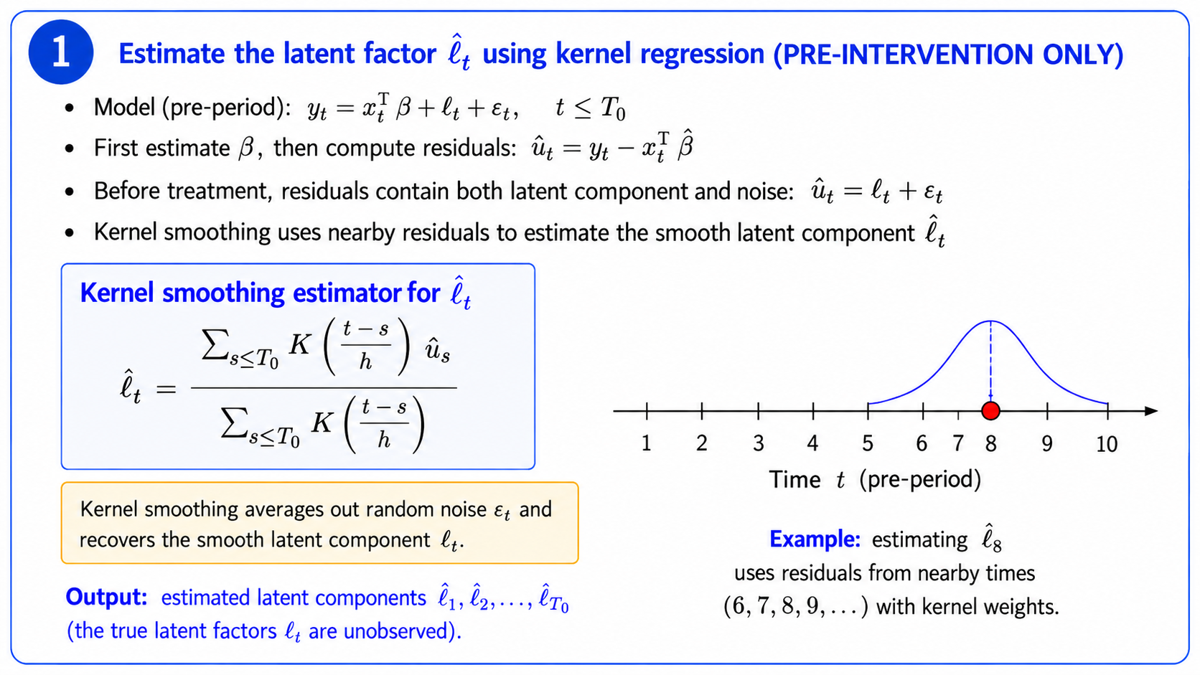

Slide 4
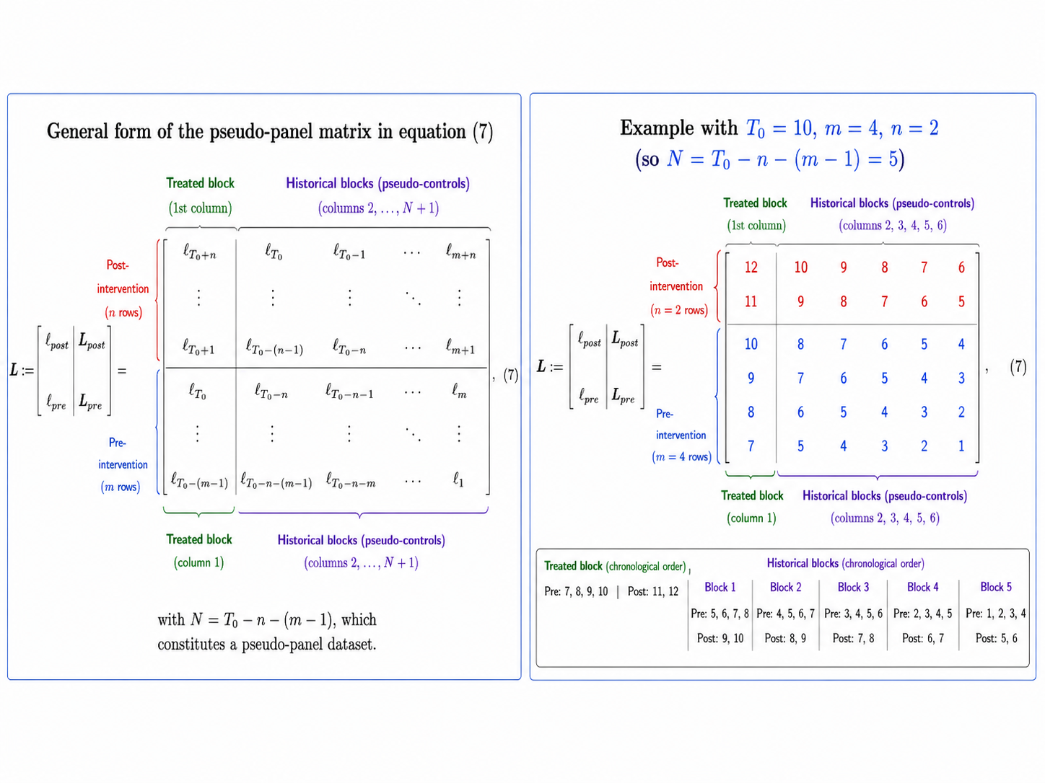

Slide 5
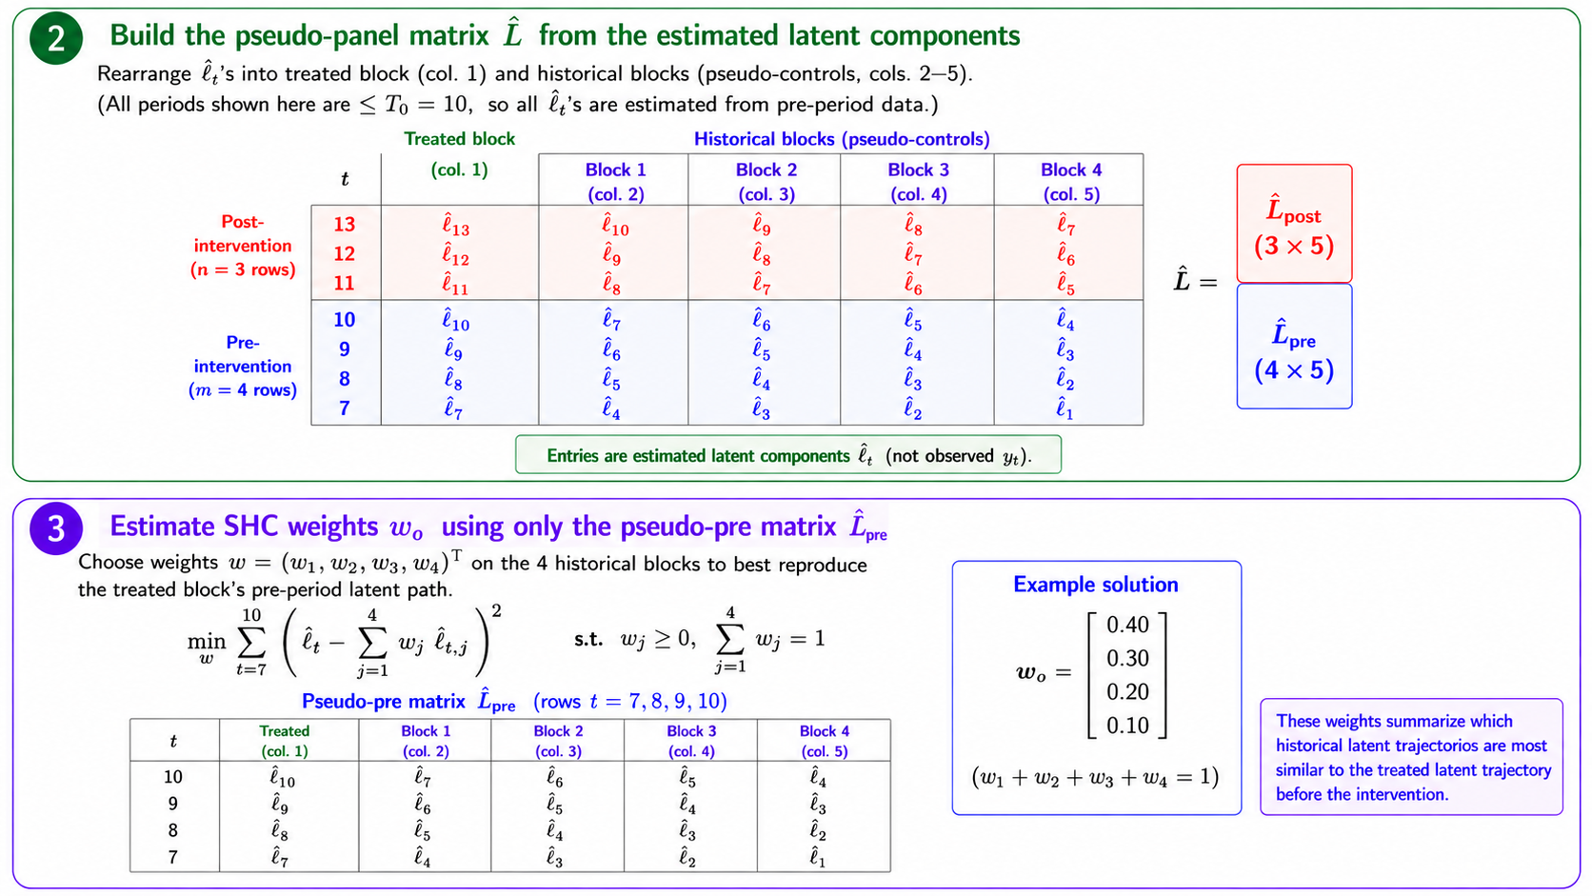

Slide 6
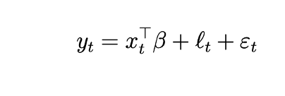
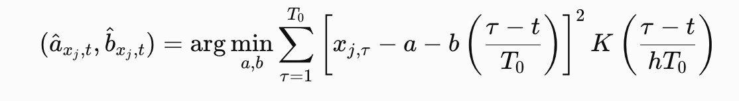

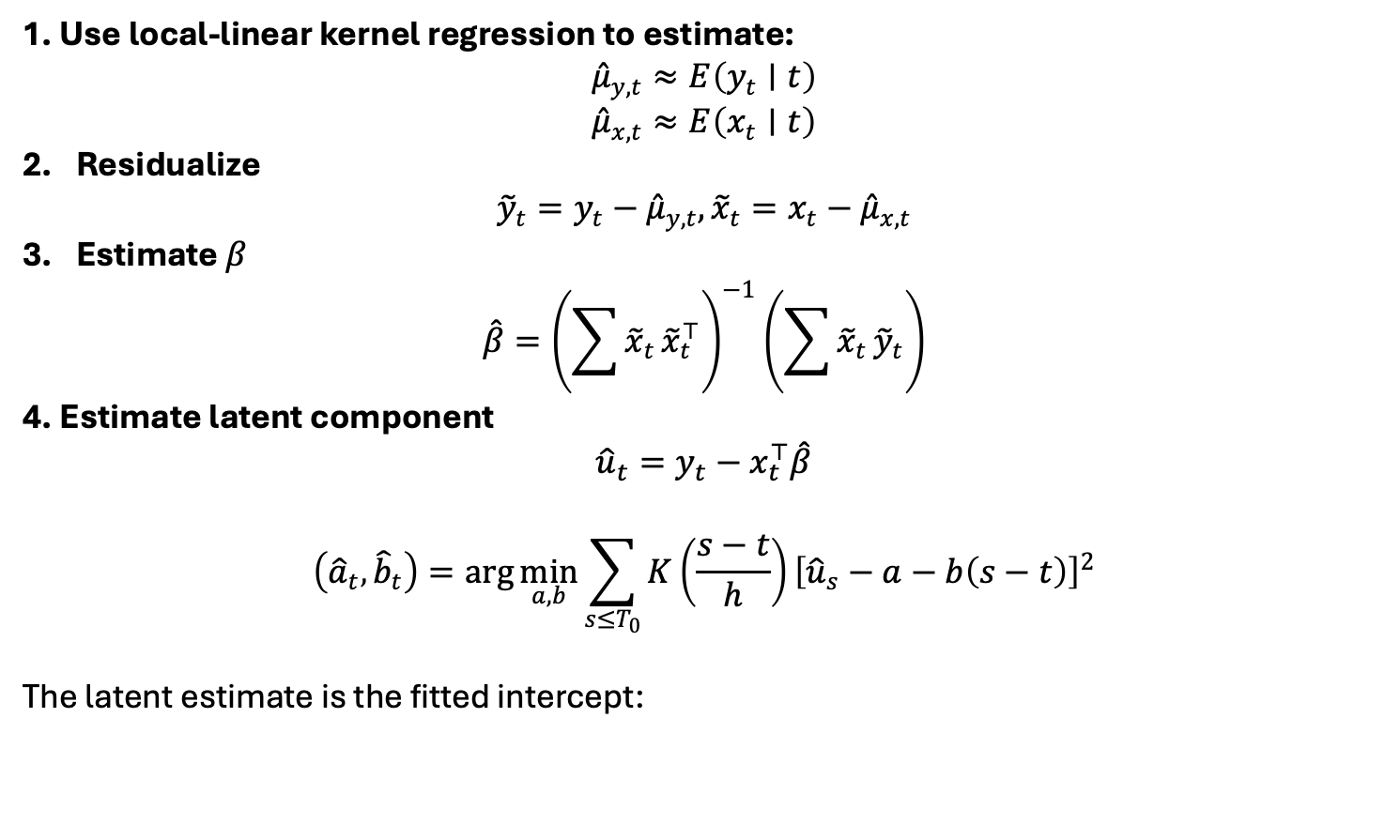
First Stage: Estimate Beta and Latent Component
1. Use local-linear kernel regression to estimate:
$${\hat{μ}}_{y,t}≈E\left(y_{t}∣t\right)$$
$${\hat{μ}}_{x,t}≈E\left(x_{t}∣t\right)$$
Residualize
$${\tilde{y}}_{t}=y_{t}−{\hat{μ}}_{y,t}, {\tilde{x}}_{t}=x_{t}−{\hat{μ}}_{x,t}$$
Estimate $β$
$$\hat{β}={\left(\sum{{\tilde{x}}_{t}}{\tilde{x}}_{t}^{⊤}\right)}^{−1}\left(\sum{{\tilde{x}}_{t}}{\tilde{y}}_{t}\right)$$
4. Estimate latent component
$${\hat{u}}_{t}=y_{t}−x_{t}^{⊤}\hat{β}$$
$$\left({\hat{a}}_{t} , {\hat{b}}_{t}\right)=\arg{\min_{a,b}}\sum_{s≤T_{0}}{K}\left(\frac{s−t}{h}\right){\left[{\hat{u}}_{s}−a−b\left(s−t\right)\right]}^{2}$$
The latent estimate is the fitted intercept:

Slide 7
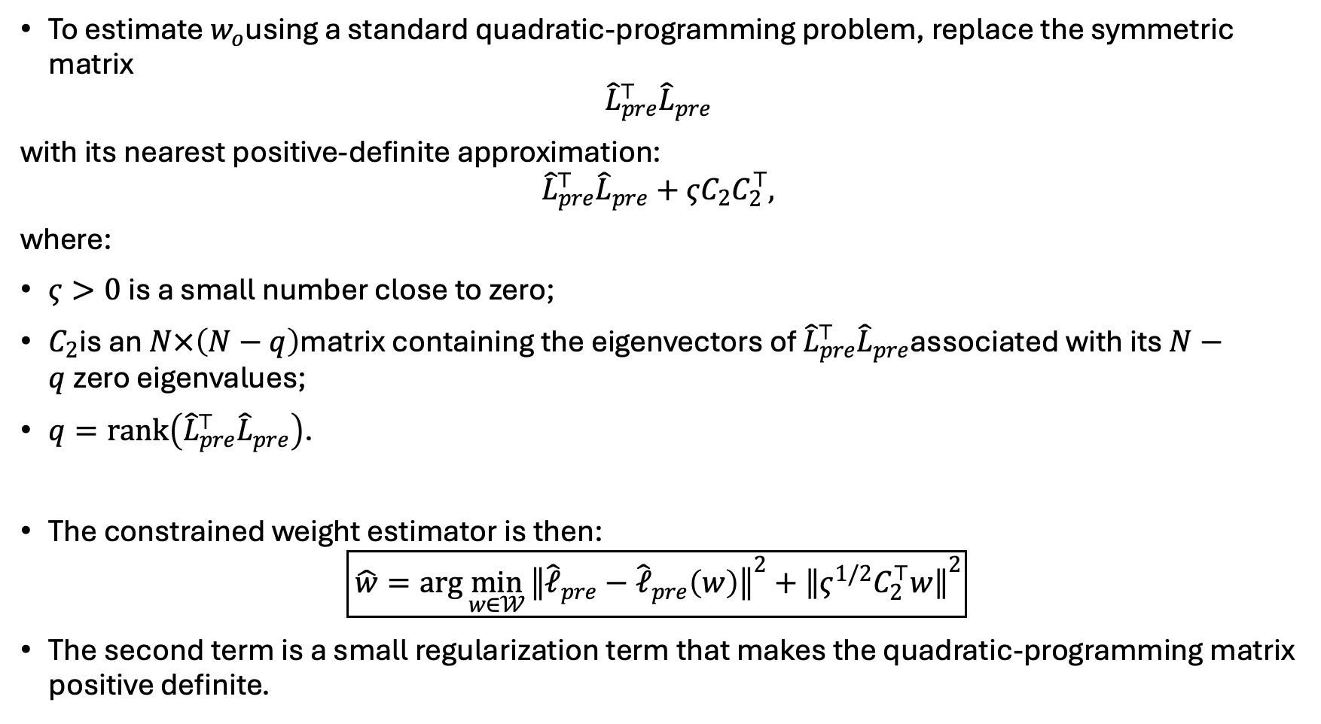
Second Stage: Estimate Weights
To estimate $w_{o}$using a standard quadratic-programming problem, replace the symmetric matrix
$${\hat{L}}_{pre}^{⊤}{\hat{L}}_{pre}$$
with its nearest positive-definite approximation:
$${\hat{L}}_{pre}^{⊤}{\hat{L}}_{pre}+ςC_{2}C_{2}^{⊤},$$
where:
$ς>0$is a small number close to zero;
$C_{2}$is an $N×\left(N−q\right)$matrix containing the eigenvectors of ${\hat{L}}_{pre}^{⊤}{\hat{L}}_{pre}$associated with its $N−q$zero eigenvalues;
$q=rank⁡\left({\hat{L}}_{pre}^{⊤}{\hat{L}}_{pre}\right)$.
The constrained weight estimator is then:
$$\boxed{\hat{w}=\arg{\min_{w∈𝒲}}{∥{\hat{ℓ}}_{pre}−{\hat{ℓ}}_{pre}\left(w\right)∥}^{2}+{∥ς^{1/2}C_{2}^{⊤}w∥}^{2}}$$
The second term is a small regularization term that makes the quadratic-programming matrix positive definite.

Slide 8
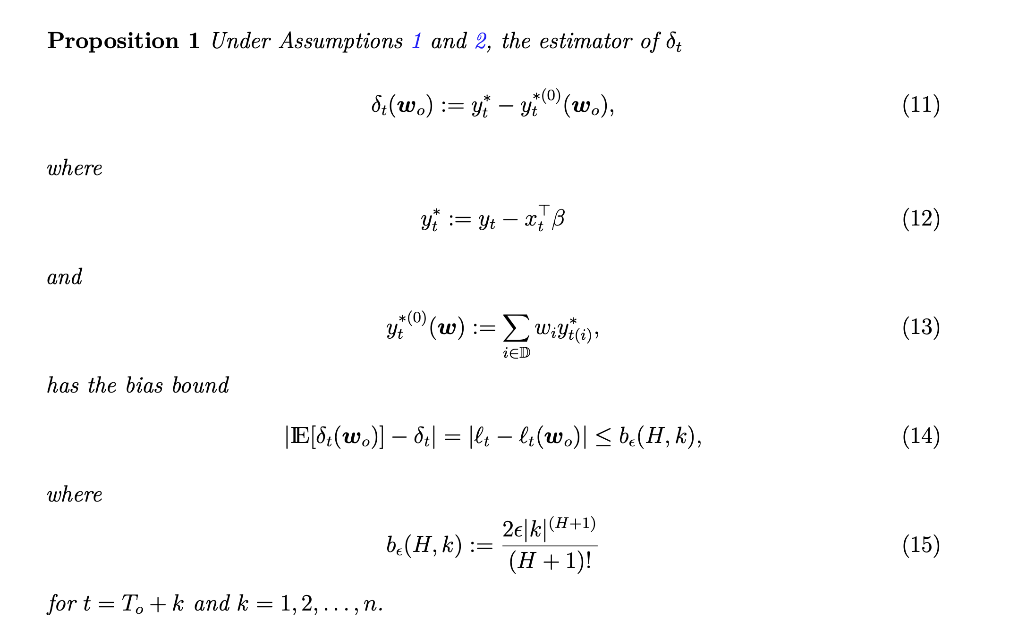
Choose n
The SHC method tends to favor a smaller n to ensure lower potential bias in finite samples

Slide 9
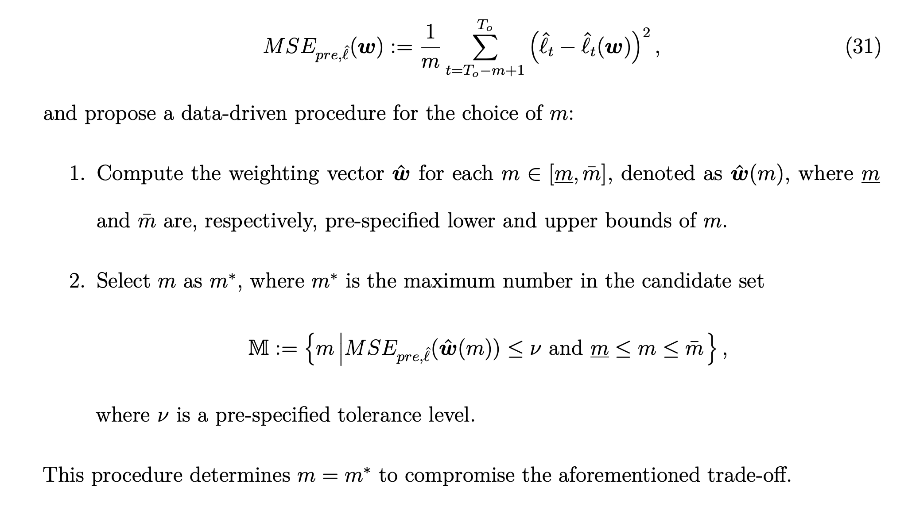
Determination of m

Slide 10
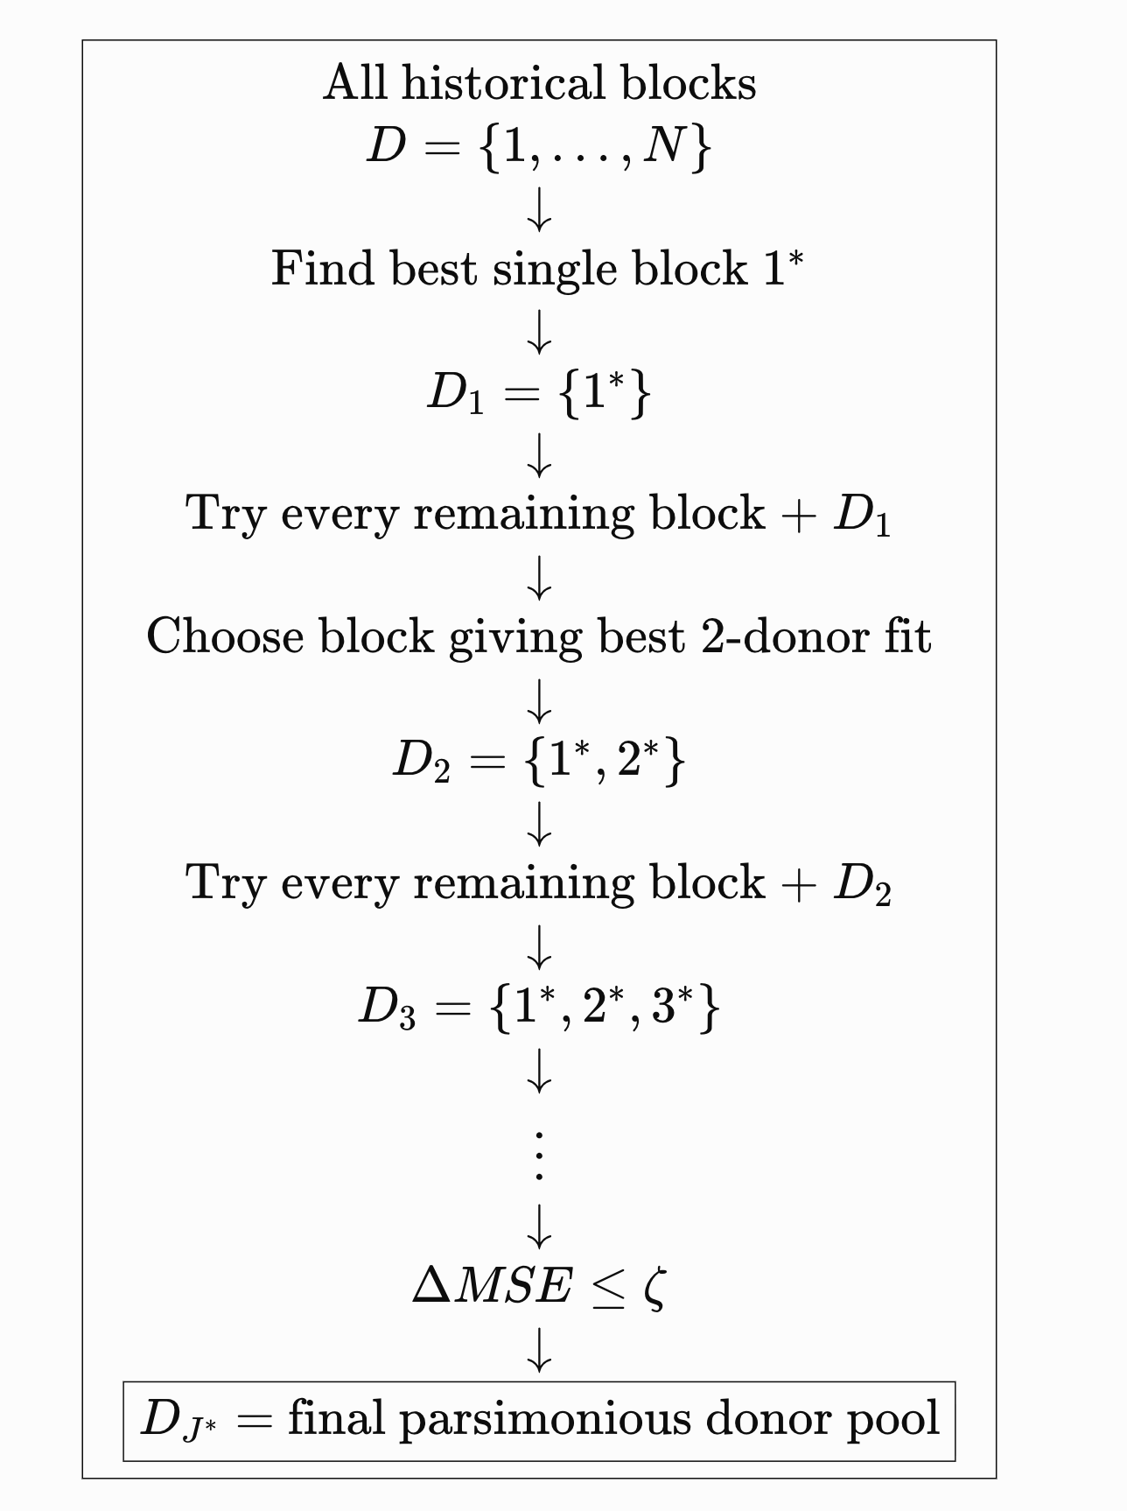
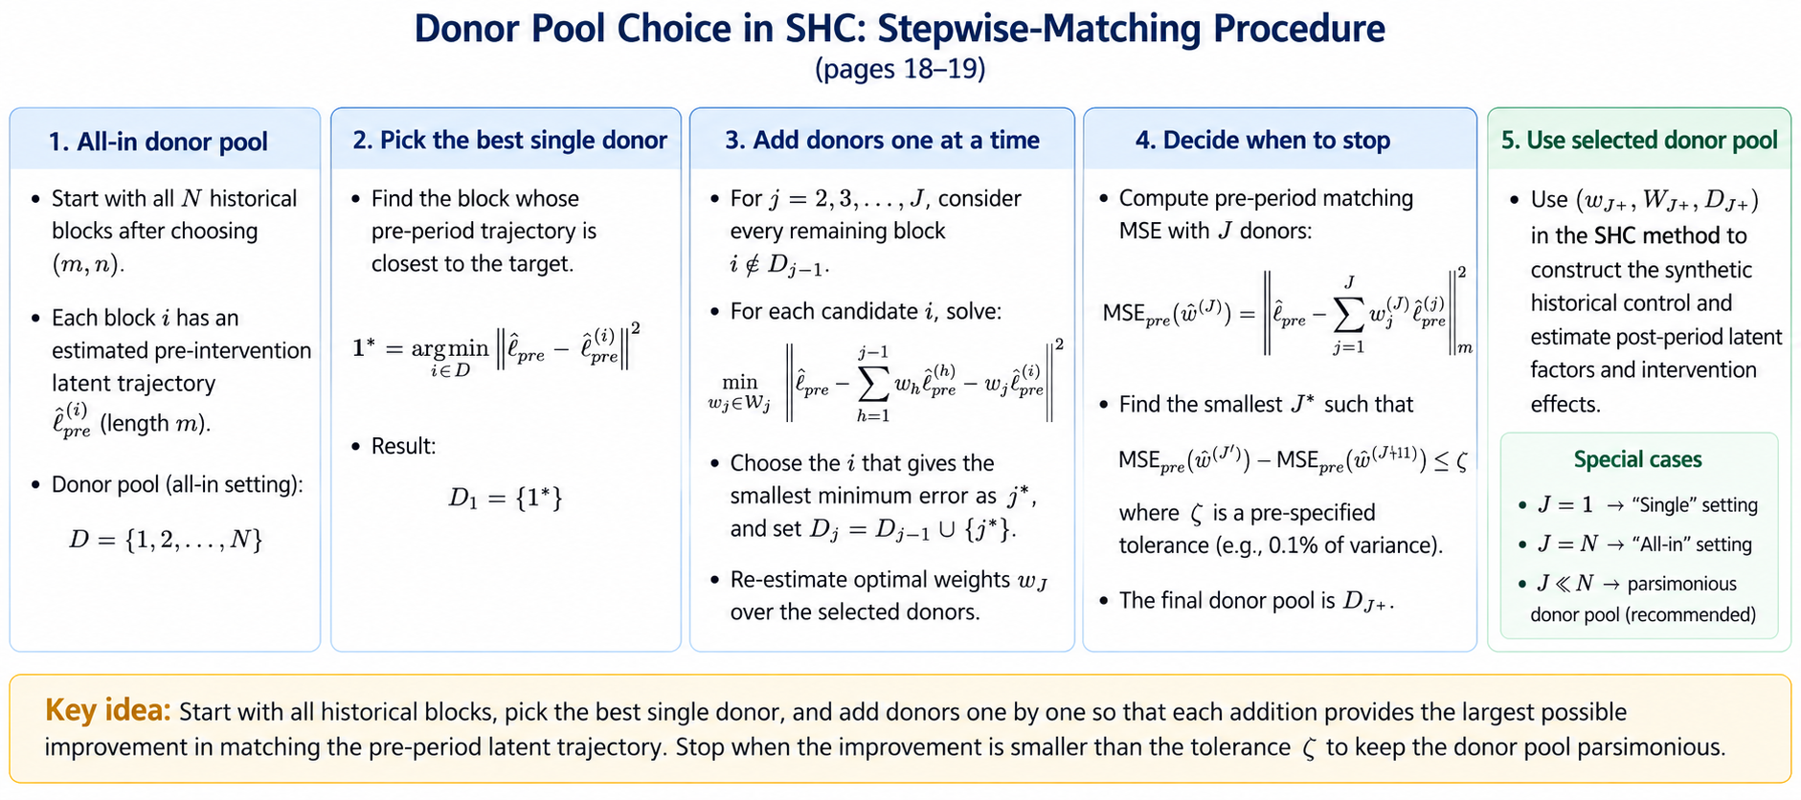
Parsimonious Donor Pool: Stepwise-matching procedure
Notes:
Start with all historical donor blocks.
Select the single donor that best matches the treated pre-treatment latent trajectory.
Add one donor at a time, choosing the donor that reduces the matching MSE the most, and re-estimate all weights.
Stop when adding another donor reduces MSE by less than the tolerance $ζ$.

Slide 11
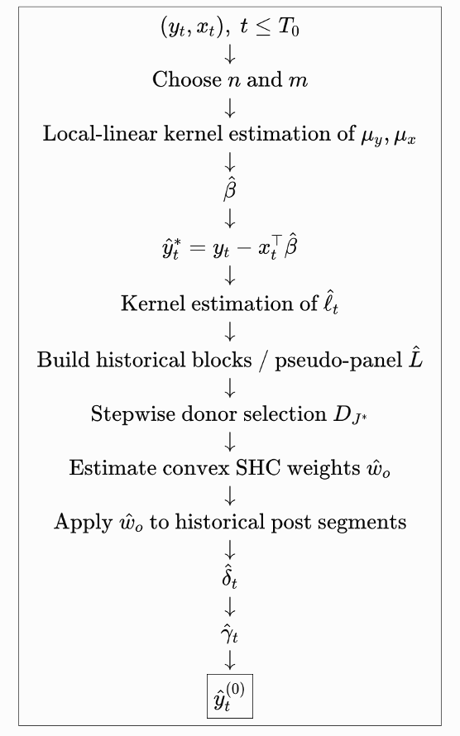

Slide 12
Monthly Sentinel 1 and Sentinel 2 Datasets
P01–P10: Nov 2023–Aug 2024, pre-Hurricane periods
P11: Sep 2024, hurricane / transition month — excluded
P12–P21: Oct 2024–Jul 2025, post-Hurricane periods
Sentinel 1: Treatment sites 1-15
Sentinel 2: Treatment sites 15-27
Number of historical donor blocks: N = T₀ - m – (n – 1); T₀=10

Slide 13
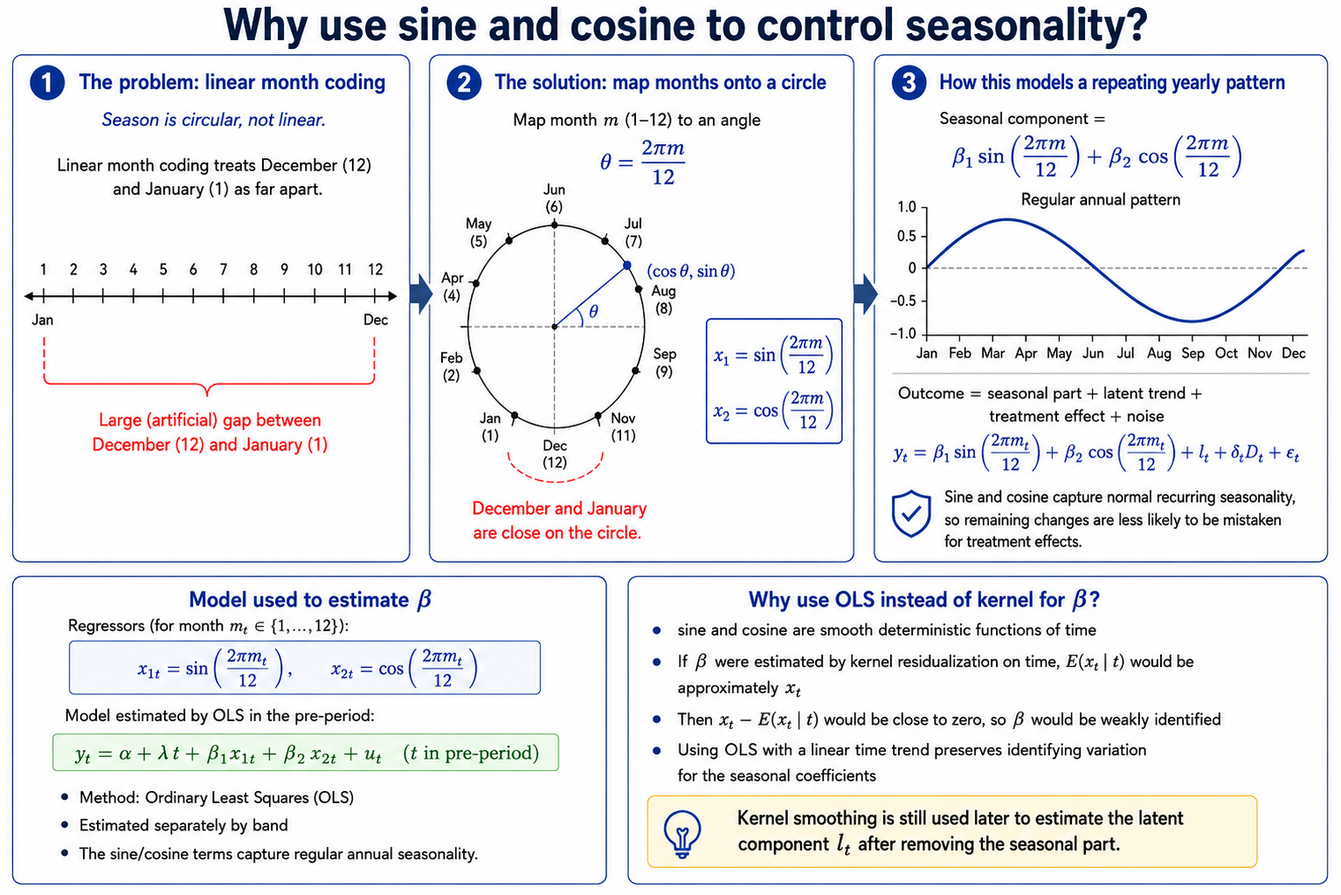
Notes:
Sine and cosine are used to capture the repeating annual seasonal pattern because months are cyclical rather than linear. We estimate the seasonal coefficients with OLS using a linear time trend, remove the seasonal component, and then use kernel smoothing on the residuals to estimate the latent component $l_{t}$.
We do not use Robinson-style kernel residualization to estimate $β$because the seasonal regressors are deterministic functions of time:
$$x_{1t}=sin⁡\left(2πt/12\right), x_{2t}=cos⁡\left(2πt/12\right).$$
If we kernel-smooth them on time, then
$$E\left(x_{t}∣t\right)≈x_{t},$$
so the residualized regressors become
$$x_{t}−E\left(x_{t}∣t\right)≈0.$$
That leaves almost no variation to identify $β$. In Robinson’s framework, identification requires $X$to contain variation that is not perfectly predictable from $Z$. Here, with $Z=t$, sine and cosine are essentially fully determined by $t$.
Therefore, in our implementation we estimate the seasonal coefficients using OLS with a linear time trend:
$$y_{t}=α+λt+β_{1}sin⁡\left(2πt/12\right)+β_{2}cos⁡\left(2πt/12\right)+u_{t}.$$
This preserves the variation in the seasonal terms. After removing the estimated seasonal component, we still use kernel smoothing to estimate the latent component $l_{t}$.
A slide-ready version:
Kernel residualization is not used for $β$because sine and cosine are deterministic functions of time. Conditioning on time would remove almost all their variation, making $β$weakly identified. We therefore estimate seasonality with OLS, then use kernel smoothing only for the latent component.

Slide 14
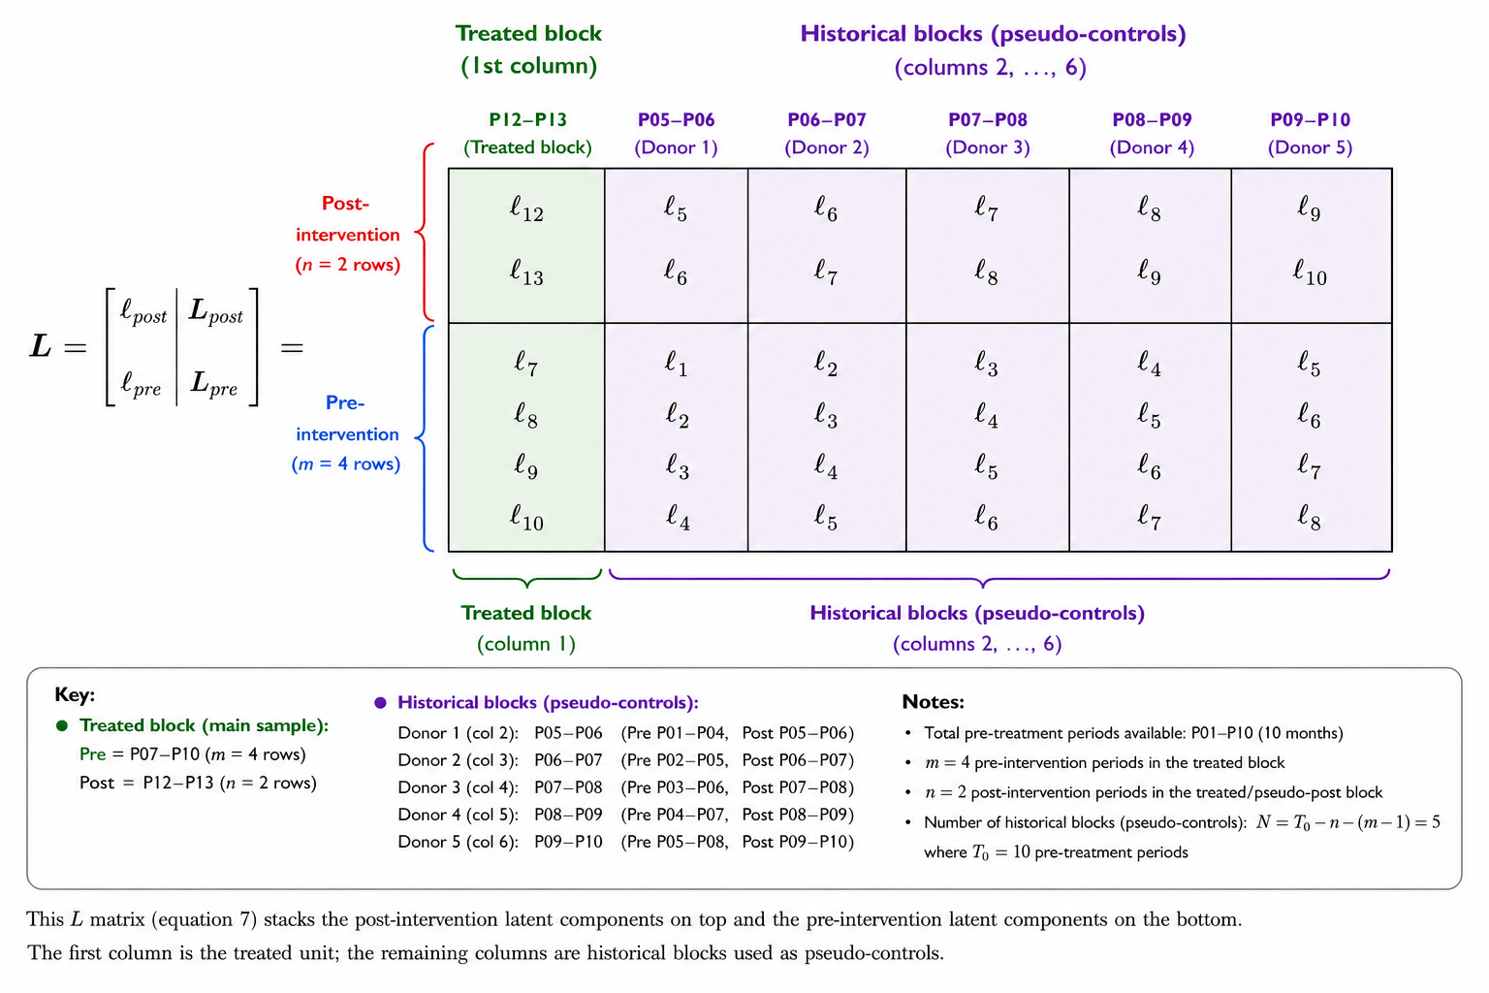

Slide 15
Steps of choosing donor pool for treatment site 15
Step | Candidate Donor | Candidate Matching Block | Selected Before | Trial Donor Pool | Trial MSE | Improvement | Trial Weights (D1,D2,D3,D4,D5) | Best in Step? | Accepted?
1 | D1 | P01–P04 | None | D1 | 3.935249 | — | (1, 0, 0, 0, 0) | No | No
1 | D2 | P02–P05 | None | D2 | 2.665662 | — | (0, 1, 0, 0, 0) | No | No
1 | D3 | P03–P06 | None | D3 | 1.739716 | — | (0, 0, 1, 0, 0) | No | No
1 | D4 | P04–P07 | None | D4 | 0.996913 | — | (0, 0, 0, 1, 0) | No | No
1 | D5 | P05–P08 | None | D5 | 0.433386 | — | (0, 0, 0, 0, 1) | Yes | Yes
2 | D1 | P01–P04 | D5 | D5 + D1 | 0.433386 | 0.000000 | (0, 0, 0, 0, 1) | Yes | No
2 | D2 | P02–P05 | D5 | D5 + D2 | 0.433386 | 0.000000 | (0, 0, 0, 0, 1) | No | No
2 | D3 | P03–P06 | D5 | D5 + D3 | 0.433386 | 0.000000 | (0, 0, 0, 0, 1) | No | No
2 | D4 | P04–P07 | D5 | D5 + D4 | 0.433386 | 0.000000 | (0, 0, 0, 0, 1) | No | No

Slide 16
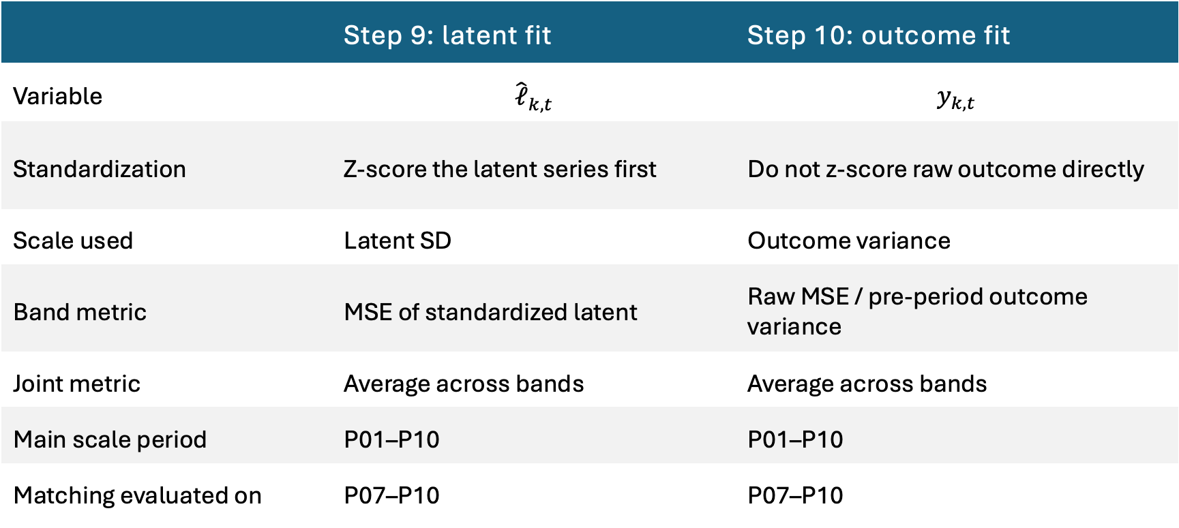
Standardized in Step 9 and Step 10
 | Step 9: latent fit | Step 10: outcome fit
Variable | $${\hat{ℓ}}_{k,t}$$ | $$y_{k,t}$$
Standardization | Z-score the latent series first | Do not z-score raw outcome directly
Scale used | Latent SD | Outcome variance
Band metric | MSE of standardized latent | Raw MSE / pre-period outcome variance
Joint metric | Average across bands | Average across bands
Main scale period | P01–P10 | P01–P10
Matching evaluated on | P07–P10 | P07–P10

Slide 17
Treatment Site | Sensor | Selected Donor | Historical Matching Block | Pseudo-Post Block | Weight | Joint Latent MSE | Joint Outcome NMSE
treatment_0015 | Sentinel-1 | D5 | P05–P06–P07–P08 | P09–P10 | 1.0000 | 0.4334 | 0.4933
treatment_0016 | Sentinel-1 | D5 | P05–P06–P07–P08 | P09–P10 | 1.0000 | 0.4354 | 0.7224
treatment_0017 | Sentinel-1 | D5 | P05–P06–P07–P08 | P09–P10 | 1.0000 | 0.4385 | 0.7958
treatment_0018 | Sentinel-1 | D5 | P05–P06–P07–P08 | P09–P10 | 1.0000 | 0.4416 | 0.9673
treatment_0019 | Sentinel-1 | D5 | P05–P06–P07–P08 | P09–P10 | 1.0000 | 0.4430 | 1.1622
treatment_0020 | Sentinel-1 | D5 | P05–P06–P07–P08 | P09–P10 | 1.0000 | 0.4415 | 0.7728
treatment_0021 | Sentinel-1 | D5 | P05–P06–P07–P08 | P09–P10 | 1.0000 | 0.4343 | 0.4609
treatment_0022 | Sentinel-1 | D5 | P05–P06–P07–P08 | P09–P10 | 1.0000 | 0.4360 | 0.6252
treatment_0023 | Sentinel-1 | D5 | P05–P06–P07–P08 | P09–P10 | 1.0000 | 0.4937 | 1.9815
treatment_0024 | Sentinel-1 | D5 | P05–P06–P07–P08 | P09–P10 | 1.0000 | 0.4385 | 1.1956
treatment_0025 | Sentinel-1 | D5 | P05–P06–P07–P08 | P09–P10 | 1.0000 | 0.4426 | 1.0829
treatment_0027 | Sentinel-1 | D5 | P05–P06–P07–P08 | P09–P10 | 1.0000 | 0.4462 | 1.1727
treatment_0001 | Sentinel-2 | D5 | P05–P06–P07–P08 | P09–P10 | 1.0000 | 0.7523 | 0.7770
treatment_0002 | Sentinel-2 | D5 | P05–P06–P07–P08 | P09–P10 | 1.0000 | 0.5008 | 1.6125
treatment_0003 | Sentinel-2 | D5 | P05–P06–P07–P08 | P09–P10 | 1.0000 | 0.6673 | 1.8945
treatment_0004 | Sentinel-2 | D5 | P05–P06–P07–P08 | P09–P10 | 1.0000 | 0.6831 | 1.9958
treatment_0005 | Sentinel-2 | D5 | P05–P06–P07–P08 | P09–P10 | 1.0000 | 0.4948 | 1.8098
treatment_0006 | Sentinel-2 | D5 | P05–P06–P07–P08 | P09–P10 | 1.0000 | 0.5577 | 2.2470
treatment_0007 | Sentinel-2 | D5 | P05–P06–P07–P08 | P09–P10 | 1.0000 | 0.6003 | 2.6470
treatment_0008 | Sentinel-2 | D5 | P05–P06–P07–P08 | P09–P10 | 1.0000 | 0.7037 | 2.0231
treatment_0009 | Sentinel-2 | D5 | P05–P06–P07–P08 | P09–P10 | 1.0000 | 0.7584 | 2.0054
treatment_0010 | Sentinel-2 | D5 | P05–P06–P07–P08 | P09–P10 | 1.0000 | 0.4953 | 2.1068
treatment_0011 | Sentinel-2 | D5 | P05–P06–P07–P08 | P09–P10 | 1.0000 | 0.7960 | 2.1144
treatment_0012 | Sentinel-2 | D5 | P05–P06–P07–P08 | P09–P10 | 1.0000 | 0.6470 | 2.3582
treatment_0013 | Sentinel-2 | D5 | P05–P06–P07–P08 | P09–P10 | 1.0000 | 0.9039 | 2.2998
treatment_0014 | Sentinel-2 | D5 | P05–P06–P07–P08 | P09–P10 | 1.0000 | 0.6944 | 2.0098
treatment_0015 | Sentinel-2 | D5 | P05–P06–P07–P08 | P09–P10 | 1.0000 | 0.6380 | 1.8468

Slide 18
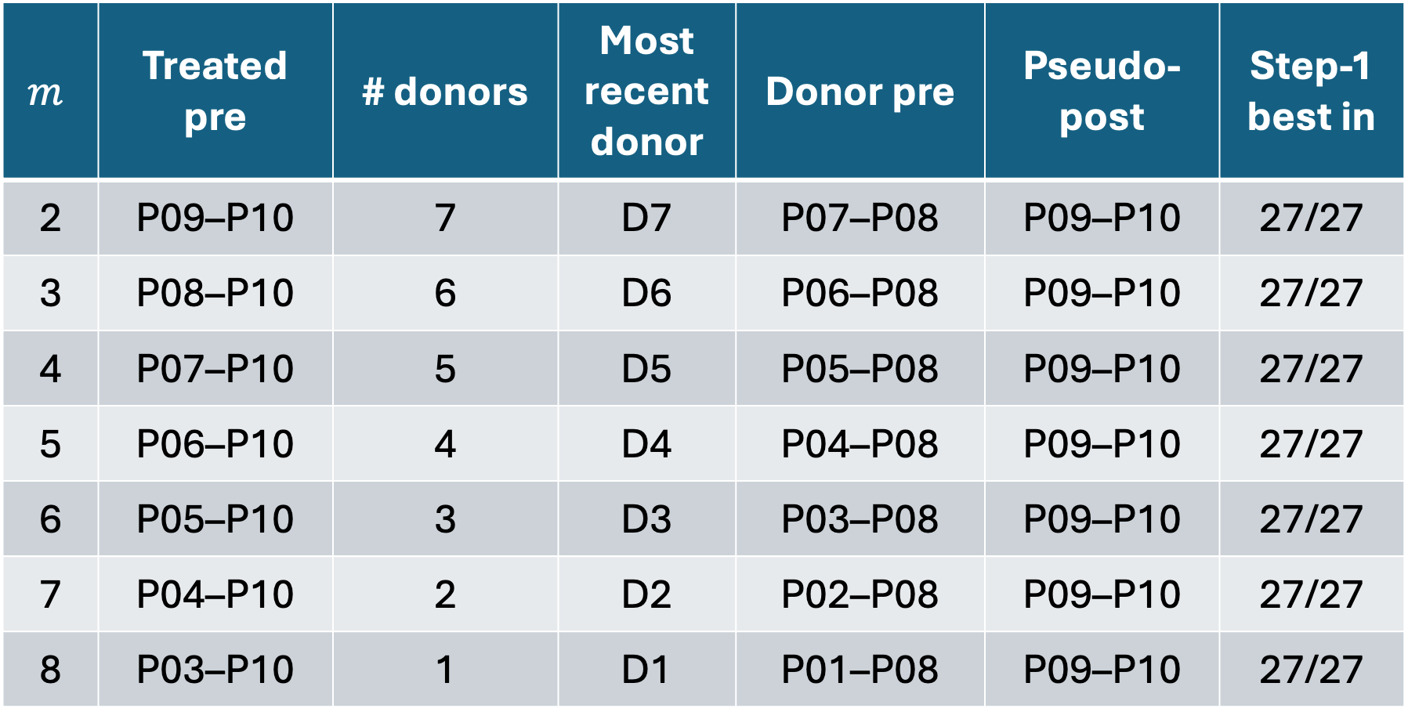
Choose Different m
$$m$$ | Treated pre | # donors | Most recent donor | Donor pre | Pseudo-post | Step-1 best in
2 | P09–P10 | 7 | D7 | P07–P08 | P09–P10 | 27/27
3 | P08–P10 | 6 | D6 | P06–P08 | P09–P10 | 27/27
4 | P07–P10 | 5 | D5 | P05–P08 | P09–P10 | 27/27
5 | P06–P10 | 4 | D4 | P04–P08 | P09–P10 | 27/27
6 | P05–P10 | 3 | D3 | P03–P08 | P09–P10 | 27/27
7 | P04–P10 | 2 | D2 | P02–P08 | P09–P10 | 27/27
8 | P03–P10 | 1 | D1 | P01–P08 | P09–P10 | 27/27
$$\boxed{\text{For every }m,\text{ the most recent feasible historical donor is the best single donor}}$$

Slide 19
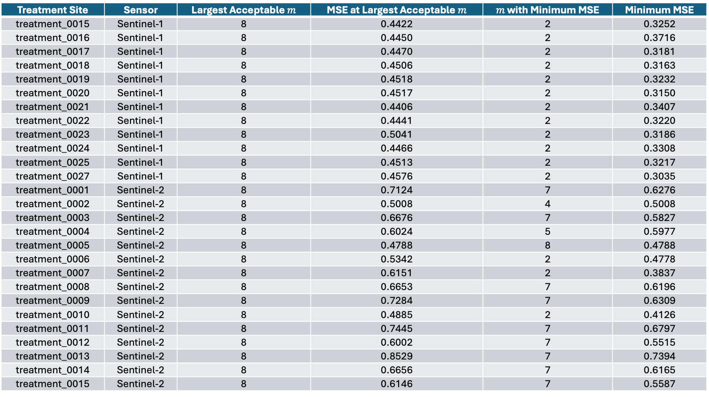

Largest Acceptable $m$: always 8
Treatment Site | Sensor | Largest Acceptable $m$ | MSE at Largest Acceptable $m$ | $m$ with Minimum MSE | Minimum MSE
treatment_0015 | Sentinel-1 | 8 | 0.4422 | 2 | 0.3252
treatment_0016 | Sentinel-1 | 8 | 0.4450 | 2 | 0.3716
treatment_0017 | Sentinel-1 | 8 | 0.4470 | 2 | 0.3181
treatment_0018 | Sentinel-1 | 8 | 0.4506 | 2 | 0.3163
treatment_0019 | Sentinel-1 | 8 | 0.4518 | 2 | 0.3232
treatment_0020 | Sentinel-1 | 8 | 0.4517 | 2 | 0.3150
treatment_0021 | Sentinel-1 | 8 | 0.4406 | 2 | 0.3407
treatment_0022 | Sentinel-1 | 8 | 0.4441 | 2 | 0.3220
treatment_0023 | Sentinel-1 | 8 | 0.5041 | 2 | 0.3186
treatment_0024 | Sentinel-1 | 8 | 0.4466 | 2 | 0.3308
treatment_0025 | Sentinel-1 | 8 | 0.4513 | 2 | 0.3217
treatment_0027 | Sentinel-1 | 8 | 0.4576 | 2 | 0.3035
treatment_0001 | Sentinel-2 | 8 | 0.7124 | 7 | 0.6276
treatment_0002 | Sentinel-2 | 8 | 0.5008 | 4 | 0.5008
treatment_0003 | Sentinel-2 | 8 | 0.6676 | 7 | 0.5827
treatment_0004 | Sentinel-2 | 8 | 0.6024 | 5 | 0.5977
treatment_0005 | Sentinel-2 | 8 | 0.4788 | 8 | 0.4788
treatment_0006 | Sentinel-2 | 8 | 0.5342 | 2 | 0.4778
treatment_0007 | Sentinel-2 | 8 | 0.6151 | 2 | 0.3837
treatment_0008 | Sentinel-2 | 8 | 0.6653 | 7 | 0.6196
treatment_0009 | Sentinel-2 | 8 | 0.7284 | 7 | 0.6309
treatment_0010 | Sentinel-2 | 8 | 0.4885 | 2 | 0.4126
treatment_0011 | Sentinel-2 | 8 | 0.7445 | 7 | 0.6797
treatment_0012 | Sentinel-2 | 8 | 0.6002 | 7 | 0.5515
treatment_0013 | Sentinel-2 | 8 | 0.8529 | 7 | 0.7394
treatment_0014 | Sentinel-2 | 8 | 0.6656 | 7 | 0.6165
treatment_0015 | Sentinel-2 | 8 | 0.6146 | 7 | 0.5587

Slide 20
Weekly Sentinel 1 data
Before Hurricane
  W01: Nov 3–Nov 9, 2023
  W47: Sep 20–Sep 26, 2024
Number of historical donor blocks: N = T0 - m – (n -1); T0=47
All 27 treatment sites

Slide 21
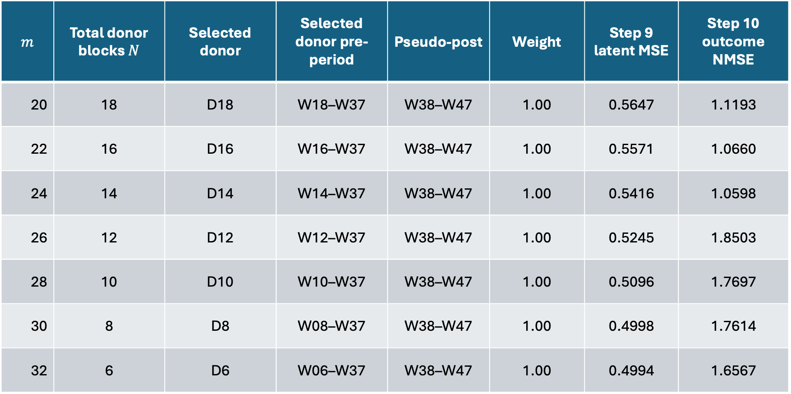
1. Fix $n=10$, change m : every $m$selects the most recent feasible donor. latent MSE decrease with m
$$m$$ | Total donor blocks $N$ | Selected donor | Selected donor pre-period | Pseudo-post | Weight | Step 9 latent MSE | Step 10 outcome NMSE
20 | 18 | D18 | W18–W37 | W38–W47 | 1.00 | 0.5647 | 1.1193
22 | 16 | D16 | W16–W37 | W38–W47 | 1.00 | 0.5571 | 1.0660
24 | 14 | D14 | W14–W37 | W38–W47 | 1.00 | 0.5416 | 1.0598
26 | 12 | D12 | W12–W37 | W38–W47 | 1.00 | 0.5245 | 1.8503
28 | 10 | D10 | W10–W37 | W38–W47 | 1.00 | 0.5096 | 1.7697
30 | 8 | D8 | W08–W37 | W38–W47 | 1.00 | 0.4998 | 1.7614
32 | 6 | D6 | W06–W37 | W38–W47 | 1.00 | 0.4994 | 1.6567

Slide 22
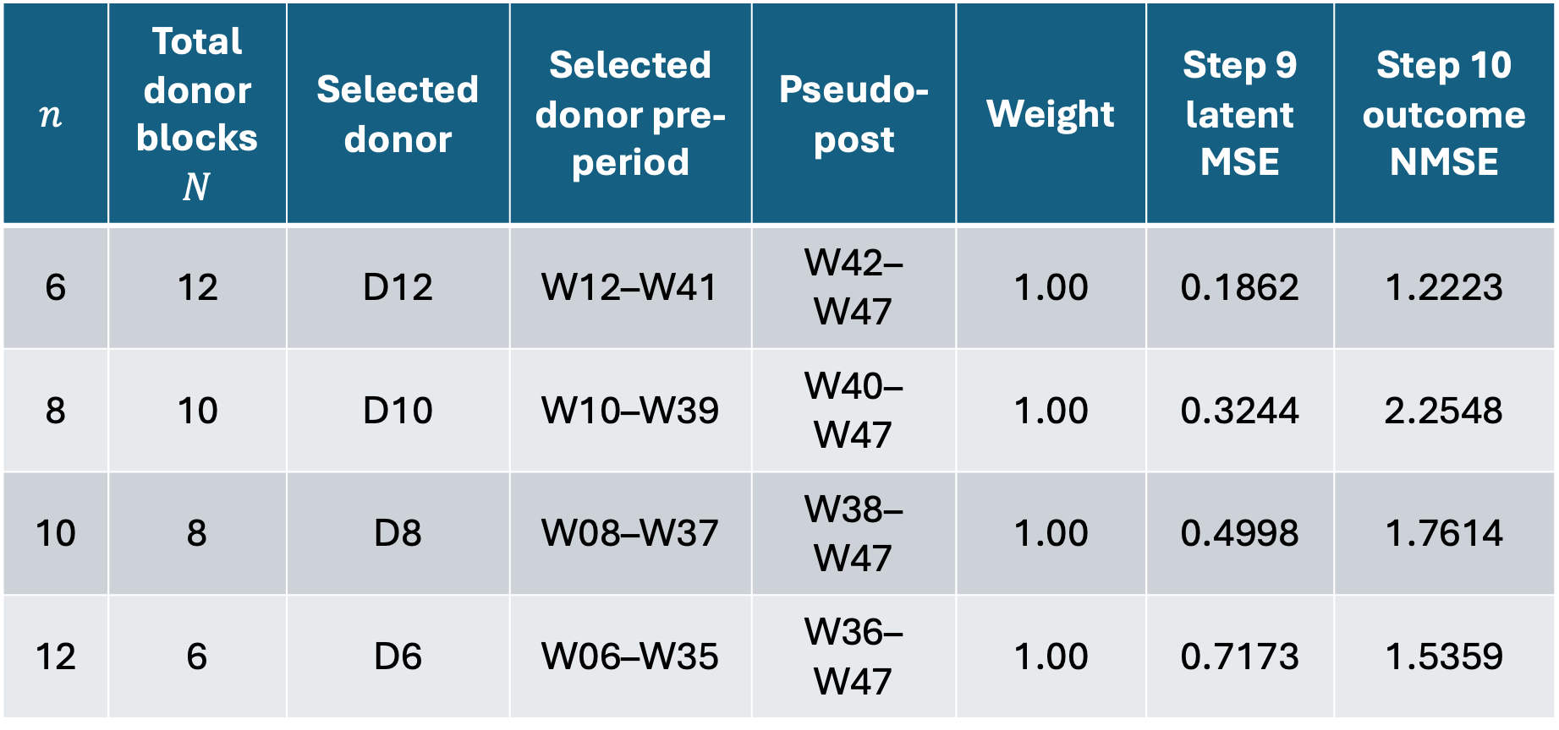
2. Fix $m=30$, change n: every n selects the most recent feasible donor. latent MSE increase with n
$$n$$ | Total donor blocks $N$ | Selected donor | Selected donor pre-period | Pseudo-post | Weight | Step 9 latent MSE | Step 10 outcome NMSE
6 | 12 | D12 | W12–W41 | W42–W47 | 1.00 | 0.1862 | 1.2223
8 | 10 | D10 | W10–W39 | W40–W47 | 1.00 | 0.3244 | 2.2548
10 | 8 | D8 | W08–W37 | W38–W47 | 1.00 | 0.4998 | 1.7614
12 | 6 | D6 | W06–W35 | W36–W47 | 1.00 | 0.7173 | 1.5359

Slide 23
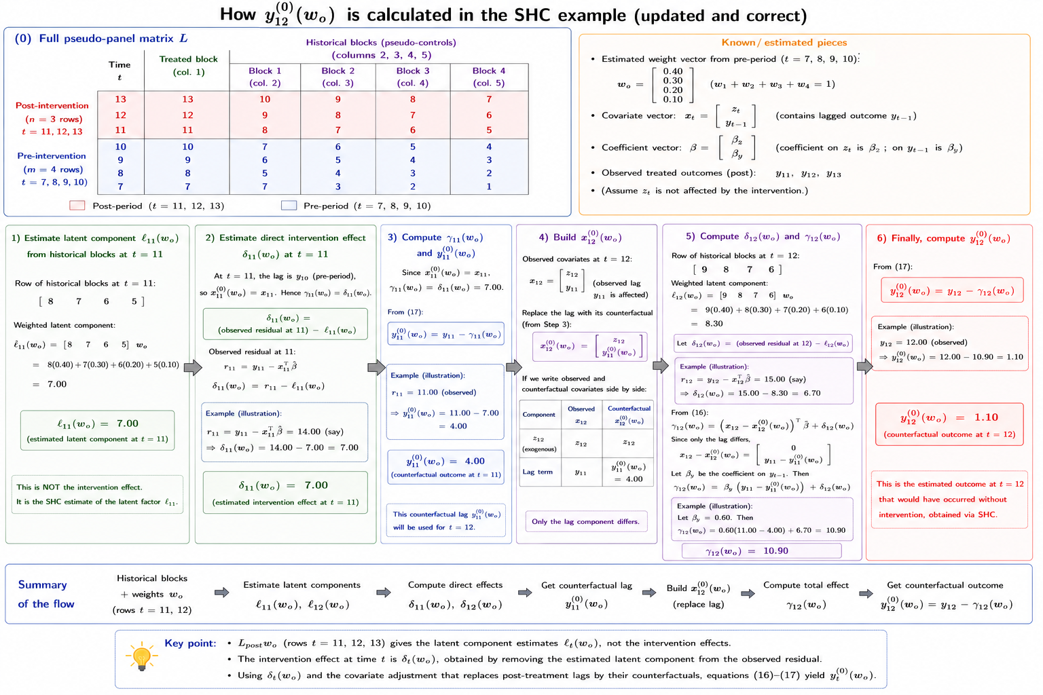

Slide 24
Key Takeaways
Monthly Image has high quality, but we have to consider if we can median image immediately after hurricane
SHC consistently selects the most recent feasible historical block as the optimal donor.
Longer pre-treatment histories are valuable because they provide more candidate donor blocks, while a shorter post-treatment horizon preserves a larger donor pool.

Slide 25
Questions Left from Last Week
How to solve cloud problem for sentinel 2
  use monthly median data
Compare sentinel 1 and sentinel 2
  Sentinel-1: best for consistent hurricane monitoring because radar works through clouds; captures moisture, surface roughness, and structural change, but bands are harder to interpret.
  Sentinel-2: better for interpreting vegetation, water, and land-cover changes; bands and indices are more intuitive, but clouds can severely reduce data quality after hurricanes.
  Overall: use Sentinel-1 for reliable temporal impact estimation and Sentinel-2 as a complementary source for interpreting the type of damage.
Consider if different bands are one domain of outcomes
  For SCM with multiple outcomes, main idea is if outcomes are effected by similar latent variables
  Sentinel-1: Multiple related radar outcomes that share common latent drivers such as moisture, roughness, vegetation structure, and surface disturbance.
  Sentinel-2: Multiple related optical outcomes that share environmental drivers but capture different physical characteristics such as vegetation, water, moisture, and reflectance.
  But different bands respond differently to these factors.

Slide 26
Imagery Quality for Monthly Data
Sensor | Group | Period | Image Numbers | Percentage of Valid Pixels
sentinel1 | counterfactual | after | 120 | 99.87582917
sentinel1 | counterfactual | before | 120 | 99.87875829
sentinel1 | treatment | after | 12 | 99.8349835
sentinel1 | treatment | before | 12 | 99.8349835
sentinel2 | counterfactual | after | 150 | 87.87452379
sentinel2 | counterfactual | before | 150 | 96.82356674
sentinel2 | treatment | after | 15 | 86.46722098
sentinel2 | treatment | before | 15 | 92.83795706

Slide 27
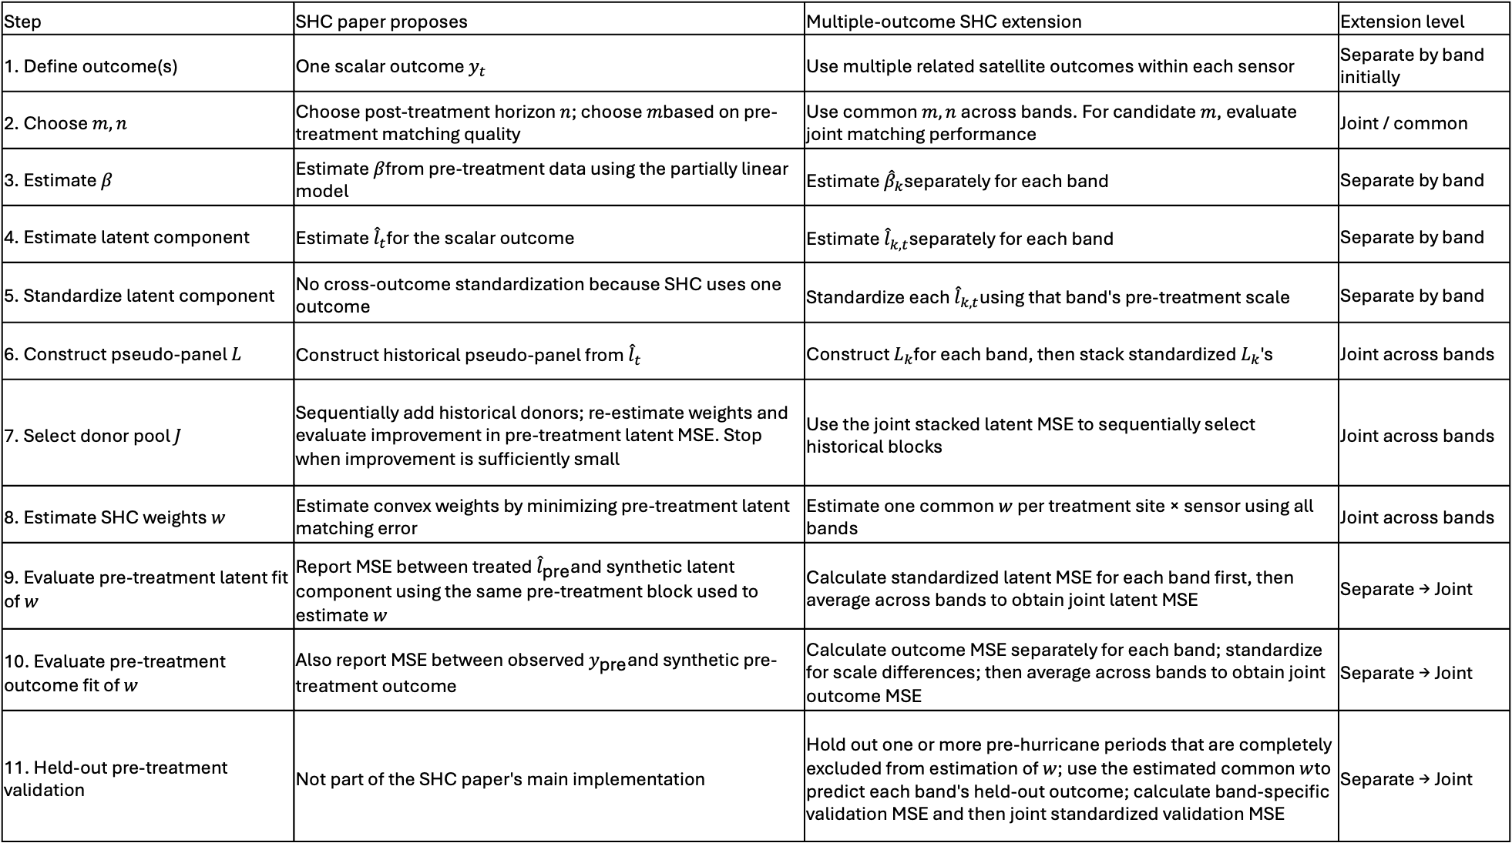
Step | SHC paper proposes | Multiple-outcome SHC extension | Extension level
1. Define outcome(s) | One scalar outcome $y_{t}$ | Use multiple related satellite outcomes within each sensor | Separate by band initially
2. Choose $m,n$ | Choose post-treatment horizon $n$; choose $m$based on pre-treatment matching quality | Use common $m,n$ across bands. For candidate $m$, evaluate joint matching performance | Joint / common
3. Estimate $β$ | Estimate $β$from pre-treatment data using the partially linear model | Estimate ${\hat{β}}_{k}$separately for each band | Separate by band
4. Estimate latent component | Estimate ${\hat{l}}_{t}$for the scalar outcome | Estimate ${\hat{l}}_{k,t}$separately for each band | Separate by band
5. Standardize latent component | No cross-outcome standardization because SHC uses one outcome | Standardize each ${\hat{l}}_{k,t}$using that band's pre-treatment scale | Separate by band
6. Construct pseudo-panel $L$ | Construct historical pseudo-panel from ${\hat{l}}_{t}$ | Construct $L_{k}$for each band, then stack standardized $L_{k}$'s | Joint across bands
7. Select donor pool $J$ | Sequentially add historical donors; re-estimate weights and evaluate improvement in pre-treatment latent MSE. Stop when improvement is sufficiently small | Use the joint stacked latent MSE to sequentially select historical blocks | Joint across bands
8. Estimate SHC weights $w$ | Estimate convex weights by minimizing pre-treatment latent matching error | Estimate one common $w$ per treatment site × sensor using all bands | Joint across bands
9. Evaluate pre-treatment latent fit of $w$ | Report MSE between treated ${\hat{l}}_{\text{pre}}$and synthetic latent component using the same pre-treatment block used to estimate $w$ | Calculate standardized latent MSE for each band first, then average across bands to obtain joint latent MSE | Separate → Joint
10. Evaluate pre-treatment outcome fit of $w$ | Also report MSE between observed $y_{\text{pre}}$and synthetic pre-treatment outcome | Calculate outcome MSE separately for each band; standardize for scale differences; then average across bands to obtain joint outcome MSE | Separate → Joint
11. Held-out pre-treatment validation | Not part of the SHC paper's main implementation | Hold out one or more pre-hurricane periods that are completely excluded from estimation of $w$; use the estimated common $w$to predict each band's held-out outcome; calculate band-specific validation MSE and then joint standardized validation MSE | Separate → Joint

